Slide 1
GUI Design MVC & Spring MVC
Sharon Mei Dec. 2013

Slide 2
Content
Principle
Pattern
Implement
Separation of Concern
Observer
Bridge
Factory – database persistence indeed
Spring MVC

Slide 3
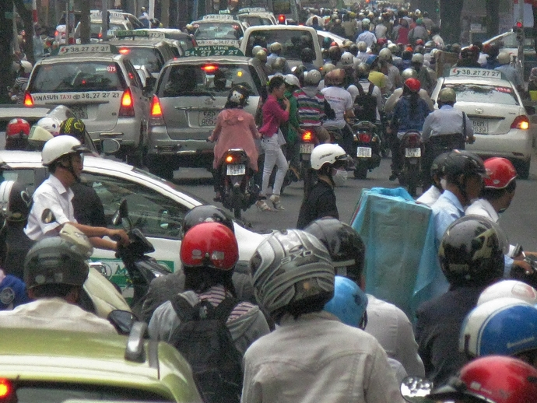
Separation of Concern

Slide 4

Factorial digit sum
Problem 20
n! means n × (n - 1) × ... × 3 × 2 × 1
For example, 10! = 10 × 9 × ... × 3 × 2 × 1 = 3628800, and the sum of the digits in the number 10! is 3 + 6 + 2 + 8 + 8 + 0 + 0 = 27.
Find the sum of the digits in the number 100!

Slide 5
public void factorial(int n, int factorial[]){
factorial[0] = 1;
k = 0;
for(int i = 2; i <= n; i++){
for(j = 0; j <= k; j++)
factorial[j] *= i;
for(j = 0; j <= k; j++){
if(factorial[j] >= 10){
factorial[j+1] += (factorial[j] - (factorial[j] % 10)) / 10;
factorial[j] = factorial[j] % 10;
if(j == k)
k++;
}
}
}
}
Concern of concatenating big integer is mixed in the logic of factorial

Slide 6
public BigInteger factorialB(int n){
BigInteger result = new BigInteger("1");
for(int i = 2; i <= n; i ++){
BigInteger factor = new BigInteger(String.valueOf(i));
result = result.multiply(factor);
}
return result;
}
Big Integer is a separate concern

Slide 7

Separation of Concern
One should avoid co-locating different concerns within the design or code
Notes:
For instance, if your application includes business logic for identifying certain noteworthy items to display to the user, and your application formats such items in a certain way to make them more noticeable, it would violate separation of concerns if both the logic for determining which items were noteworthy and the formatting of these items were in the same place.
各行其道

Slide 8
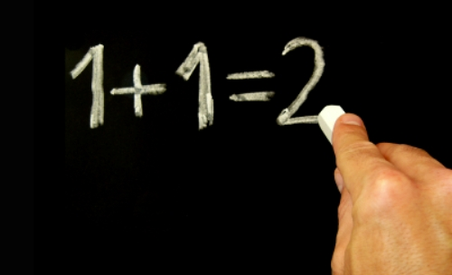
Reduce Complexity
Notes:
No where for bug to hide
Easy to understand

Slide 9

Easy to test
Notes:
Test 1 * 2
Test 1 * 2 * 3
BigInteger, a separate test

Slide 10

Open to Extension

Slide 11

Build boundary
Notes:
Private
Final
Static
…
Friends
Get
set

Slide 12
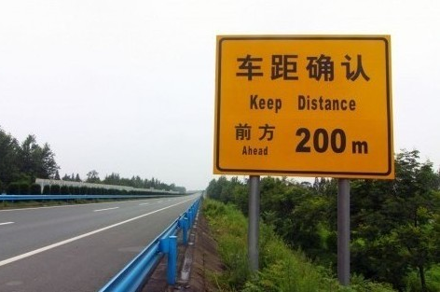
Indirection
Notes:
Dependence breaking
Code to interface

Slide 13
SOC summary
Separation of concern
Why
How

Slide 14
Observer Pattern

Slide 15

iNoodle
It turns green when noodle is ready

Slide 16
public void buttonPushed() {
int timePassed = 0;
int totalTime = 300;
setBackGround(BLUE);
putText("Noodle is not ready");
while (noodleNotReady) {
sleep(10);
timePassed += 10;
if (totalTime - timePassed <= 0) {
setBackGround(GREEN);
putText("Noodle is ready!");
}
}
}
Mixed concern of whether noddle is ready and how it is shown in screen

Slide 17
Customer loves it if it’s more fancy
Tick remaining time every second
Have a bing when noddle is ready
Prefer black bow to the blue one
Statistic on how many noodles are ready in one day

Slide 18
public void buttonPushed() {
int timePassed = 0;
int totalTime = 300;
setBackGround(BLUE);
putText("Noodle is not ready");
while (noodleNotReady) {
sleep(10);
timePassed += 10;
if (totalTime - timePassed <= 0) {
setBackGround(GREEN);
putText("Noodle is ready!");
}
}
}
Separation of Concern

Slide 19
Build Boundary
INoodle should know nothing about how it present
BLUE
GREEN
“Noodle is ready”

Slide 20
public void buttonPushed() {
int timePassed = 0;
int totalTime = 300;
screen.noodleNotReady();
while (noodleNotReady) {
sleep(10);
timePassed += 10;
if (totalTime - timePassed <= 0) {
screen.noodleReady();
}
}
}
class Screen{
public void noodleNotReady(){
setBackGround(BLUE);
putText("Noodle is not ready");
}
public void noodleReady(){
setBackGround(GREEN);
putText("Noodle is ready");
}
}
INoodle should know nothing about how it present
BLUE
GREEN
“Noodle is ready”

Slide 21
Indirection
INoodle tells it’s state to abstraction instead of concrete object
INoodle
Screen
INoodle
Observer
Screen

Slide 22
Observer Pattern Summary
View is a separate concern

Slide 23
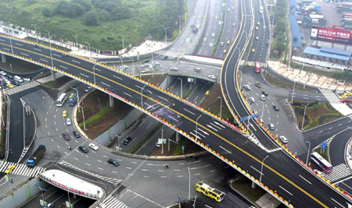
Bridge

Slide 24
class HeatButton extends Button{
public void pushed() {
if (waterInBow()) heater.turnOn();
else observer.warning();
}
class StartButton extends Button{
public void pushed(){
int timePassed = 0;
int totalTime = 300;
observer.noodleNotReady();
while (noodleNotReady) {
sleep(10);
timePassed += 10;
if (totalTime - timePassed == 0) {
observer.noodleReady();
}
}
}
}
What if we want a wheel instead of buttons

Slide 25
Practice
Separate the concern of intention and implementation

Slide 26
Bridge Pattern
UIElement
Action
Wheel
Button
Heat
Start

Slide 27
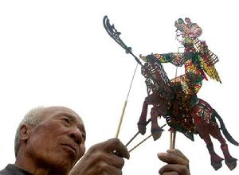
MVC

Slide 28
MVC
Controller
Model
View
Notes:
hibernate

Slide 29
MVC
Controller
Model
View

Slide 30
MVC
Controller
Model
View

Slide 31
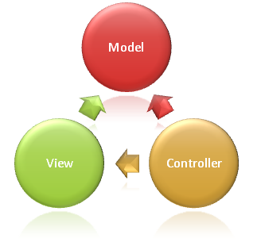
Model, Control, View
Key
Separate Presentation
State update indirectly

Slide 32
Summary
MVC

Slide 33
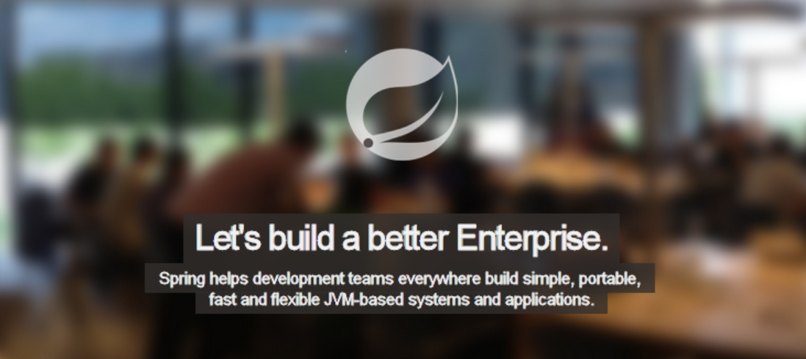
Spring web MVC framework

Slide 34
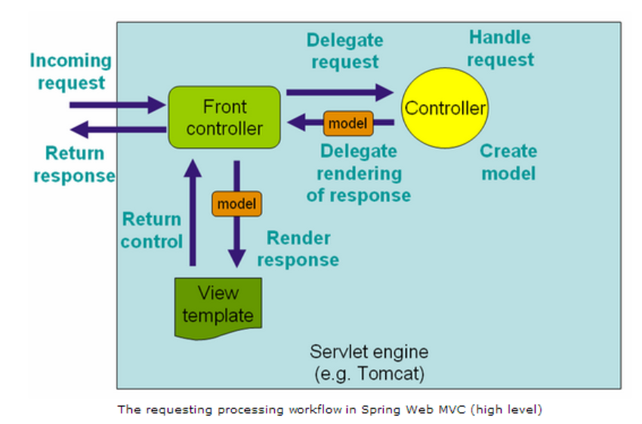

Slide 36
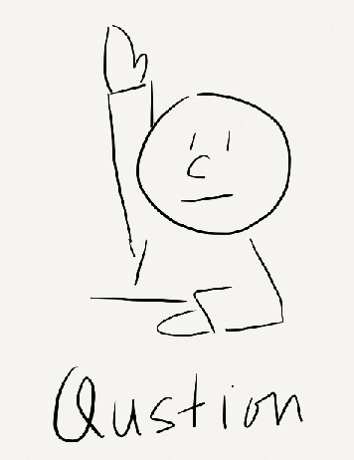
Questions

Slide 37
Testing
Programming
Presenting
@SharonMei1219

